Slide 1
Claim Analysis
Using Excel

Slide 2
Data Explanation
The main goal was to understand the data and answer business questions.
The dataset has:
10 Columns (Patient, Age, Gender, BMI (Body Mass Index), Blood Pressure, Diabetic, Number of Children, Smoker, Region, Claim)
1341 Rows.

Slide 3
Business Questions to answer
I choose this data because it will allow me to answer these business questions:
How many claims have been registered?
What is the total claim cost?
Which gender and region has the higher claim amount?
Is there any correlation between diseases and the claim cost?

Slide 4
Process
I started by cleansing the excel csv file (remove duplicates, formatting the data)
I answered the business questions by using Excel functions such as:
Pivot Table
Vlookup

Slide 5
Process
If statement
Count distinct
Sum
And then, I built the dashboard.

Slide 6
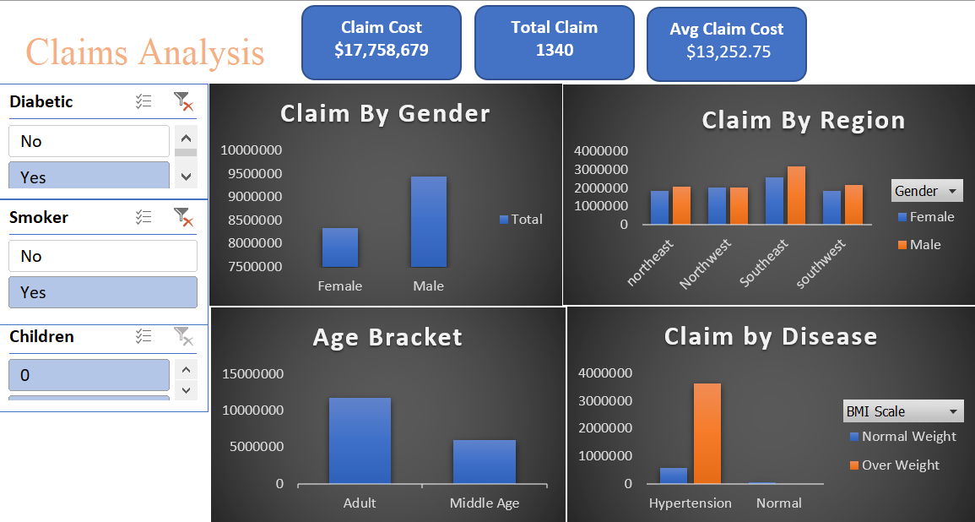

Slide 7
Findings
Overall,
We counted 1640 claims and $17,758,679 total claims cost.
Southeast is the region that has the higher claim cost ($318,879) and the male gender is predominant.
We have an increase of the claim in the middle age (age > 31 years old).
Patients with a combination of overweight and hypertension along with diabetic or are smokers have an increase of their claim cost.

Slide 8
Thanks for Reading!
Don’t forget to comment and add more insights

